Slide 1
Europe & Democracy
POL1036: Comparative European Politics – Lecture 4 - 25/1/2026

Slide 2
Schedule
Today:
The concept of Europe
The concept of Democracy
Thursday: Patterns of Democracy in Europe

Slide 3
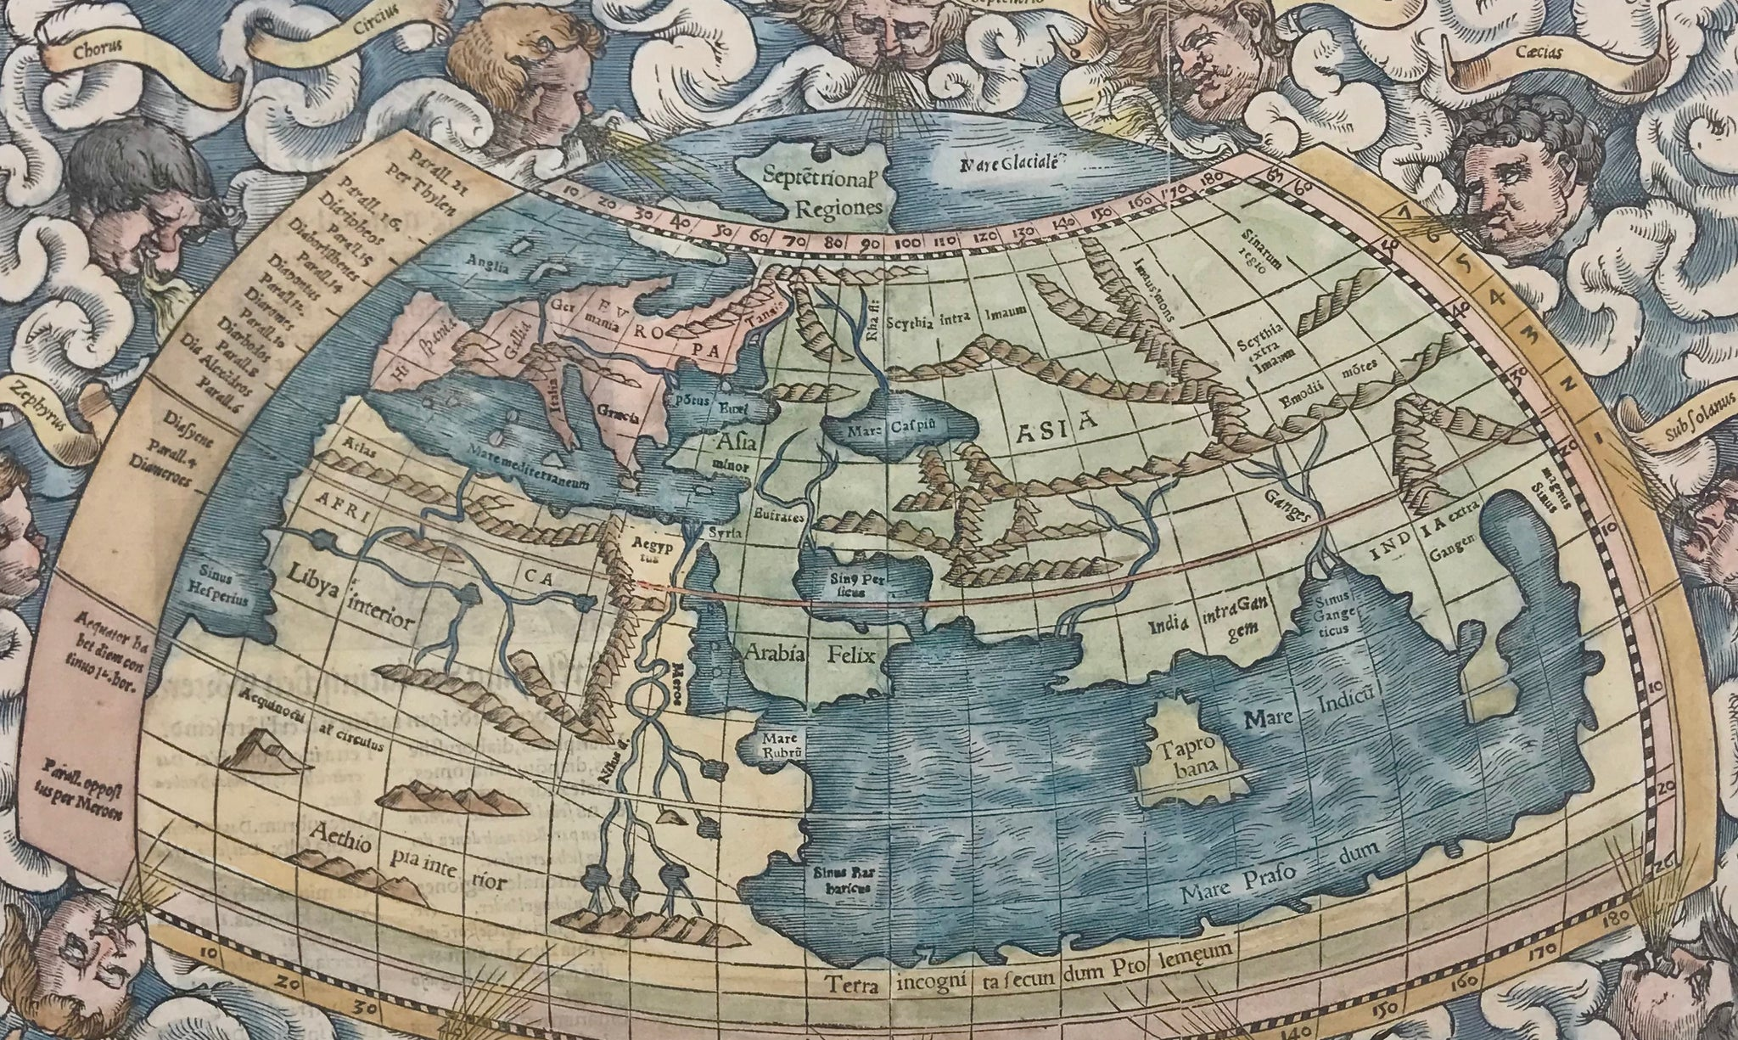




Ancient Greek Worldview
Map of the world according to Ptolemy's Geographia (2nd century CE)

Slide 4
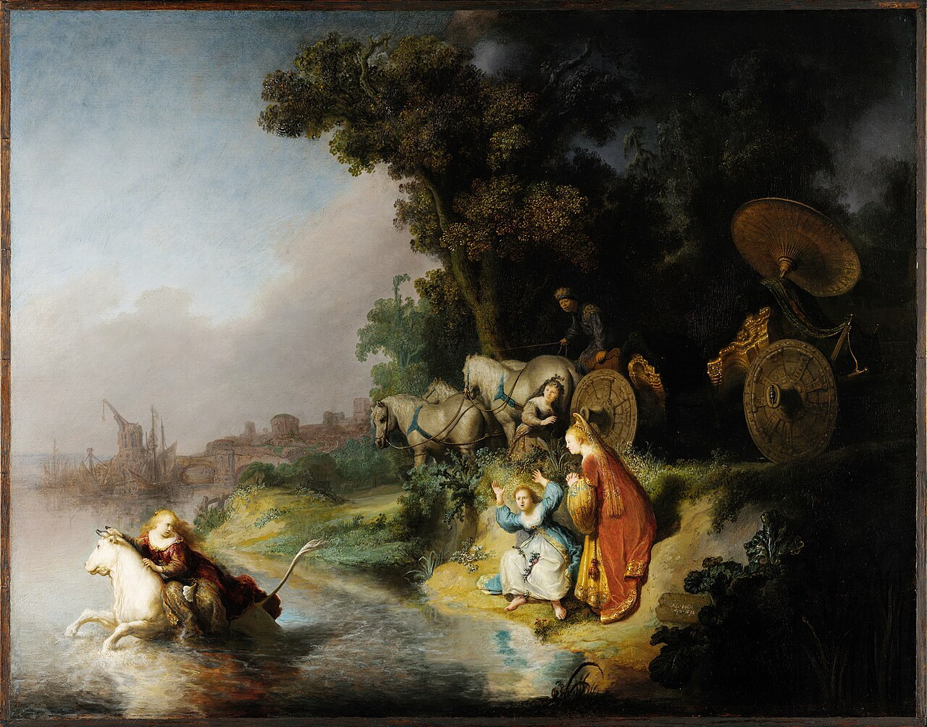
Origin?
Rembrandt's The Abduction of Europa (1632)

Slide 5
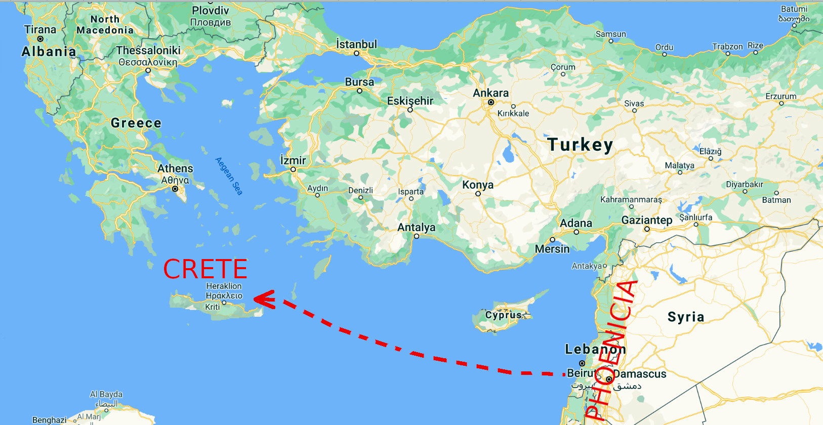
Origin?

Slide 6
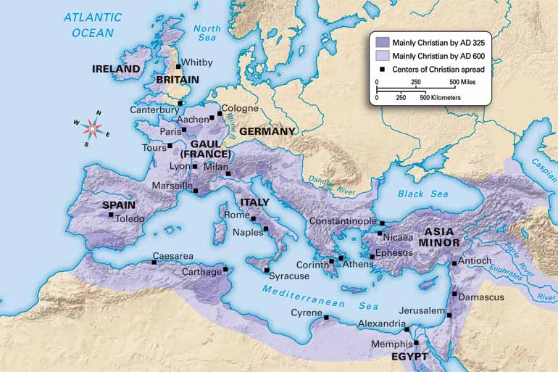
4th – 17th century: Christendom

Slide 7
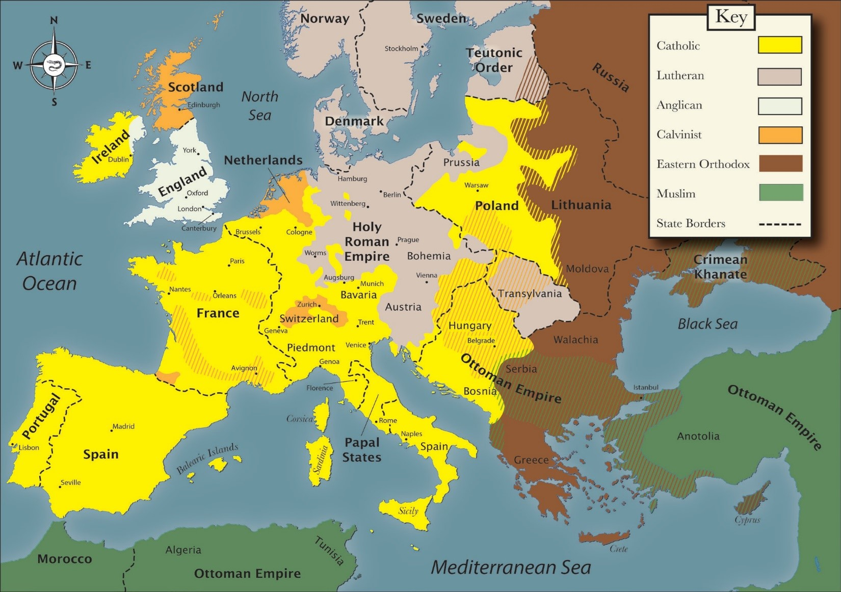
Europe before Wars of Religion (ca. 1500)

Slide 8
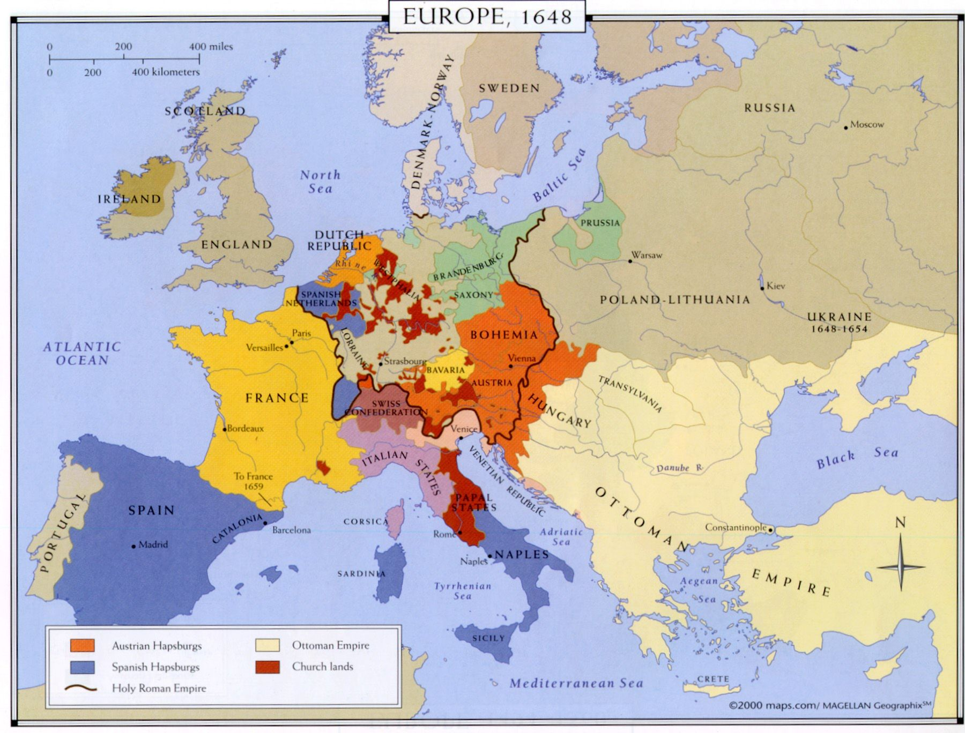
Europe after Treaty of Westphalia (1648)

Slide 9
Birth of European Identity
...a kind of great republic divided into several states, some monarchical, the others mixed… but all corresponding with one another. They all have the same religious foundation, even if divided into several confessions. They all have the same principle of public law and politics, unknown in other parts of the world.
Voltaire, Le Siècle de Louis XIV, quoted by Denys Hay, Europe: The
Emergence of an Idea (Edinburgh, 1957), 123

Slide 10
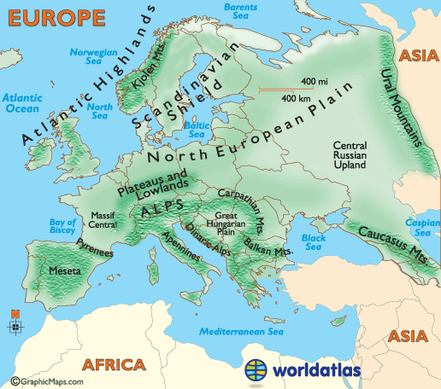
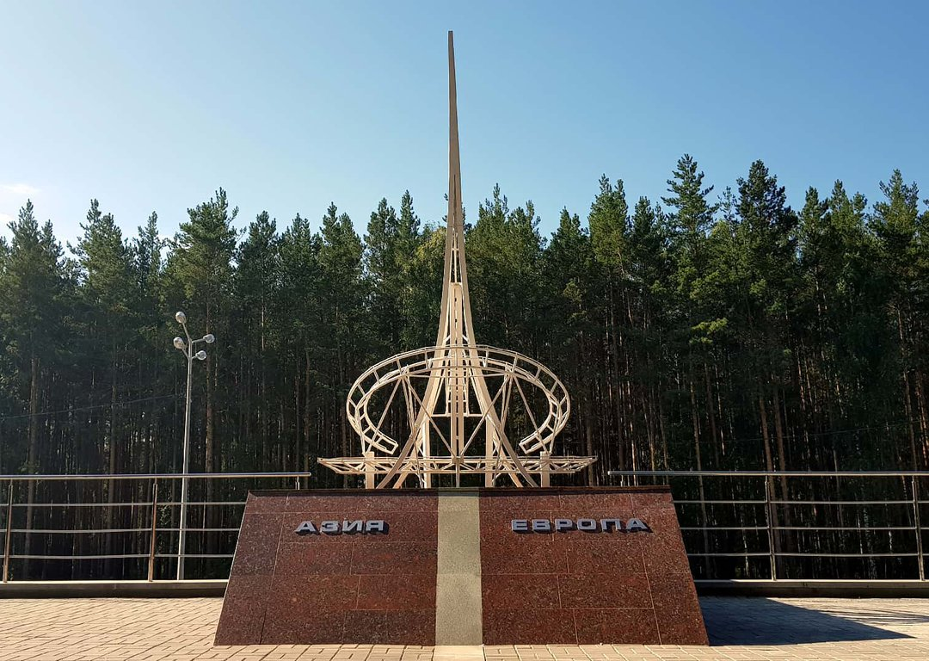


From the Atlantic to the Don to the Ural Mountains

Slide 11
The Question of Russia
"Tidal Europe"
History shows ambivalence:
Europe sees Russia as orthodox, autocratic, economically backward but expanding
Russia has never been quite sure about being a part of Europe

Slide 12
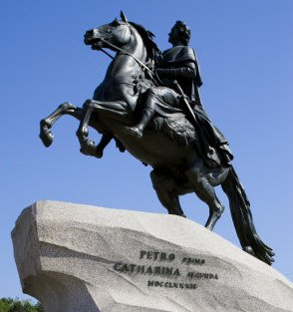
18th century: Russia Turns West
Peter the Great Europeanized Russia
Tsar (1682 – 1721)
Emperor (1721-1725)
Catherine the Great declared Russia a European state in 1767
Europe thought this was pretty chill
Russian elites were divided
Slavophiles
Westernizers
Vostochniki (Orientals)

Slide 13
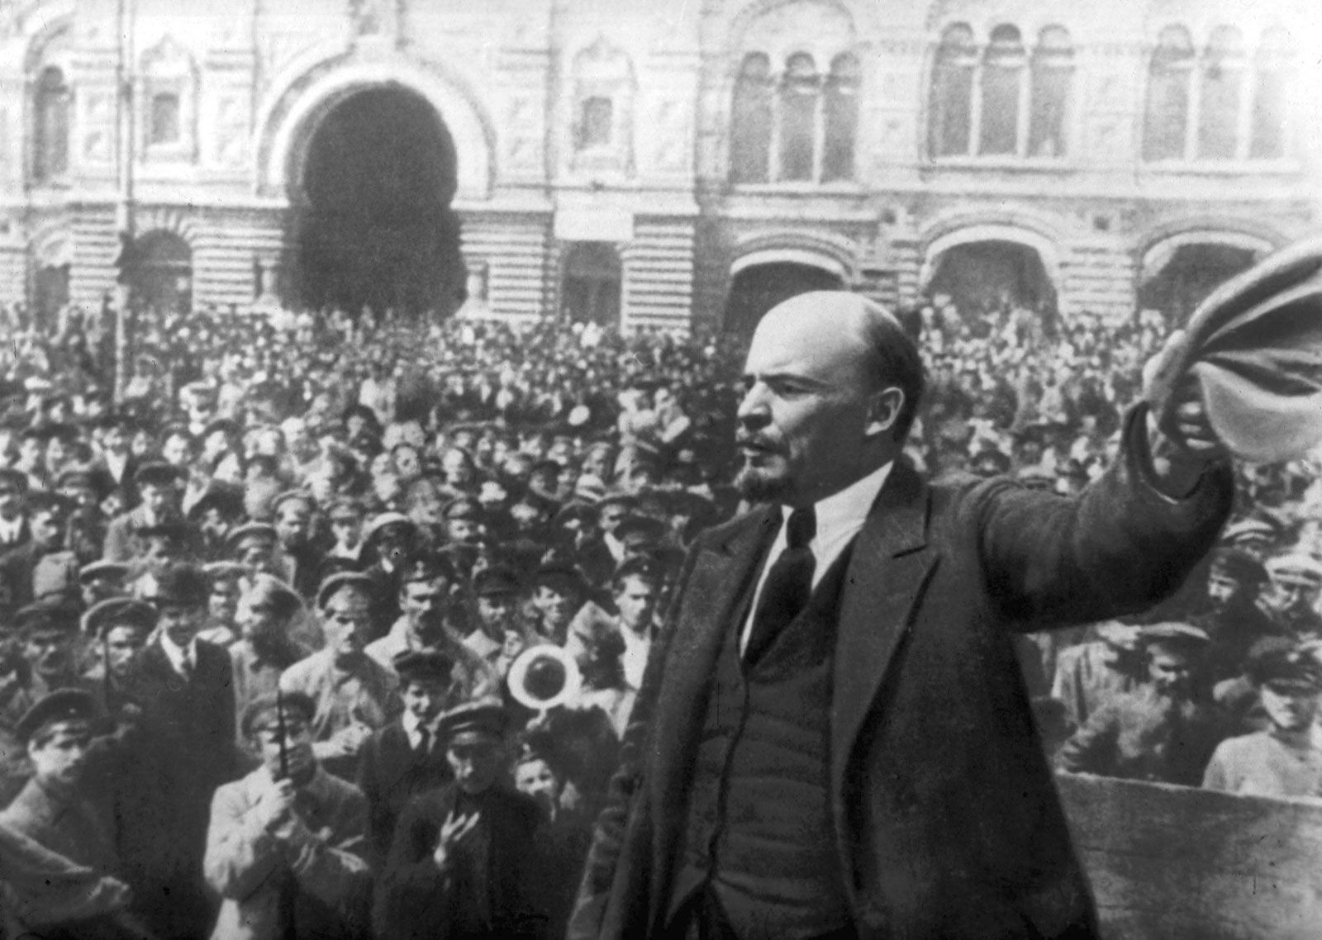
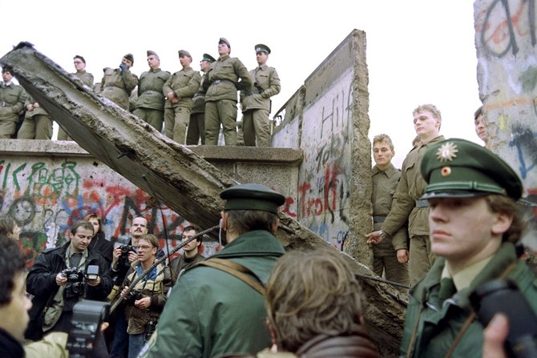
20th Century: Europe Shrinks and Expands
Exclusion after Russian Revolution (1917)
Return to Europe for CEE after fall of Communism (1989-1991)

Slide 14
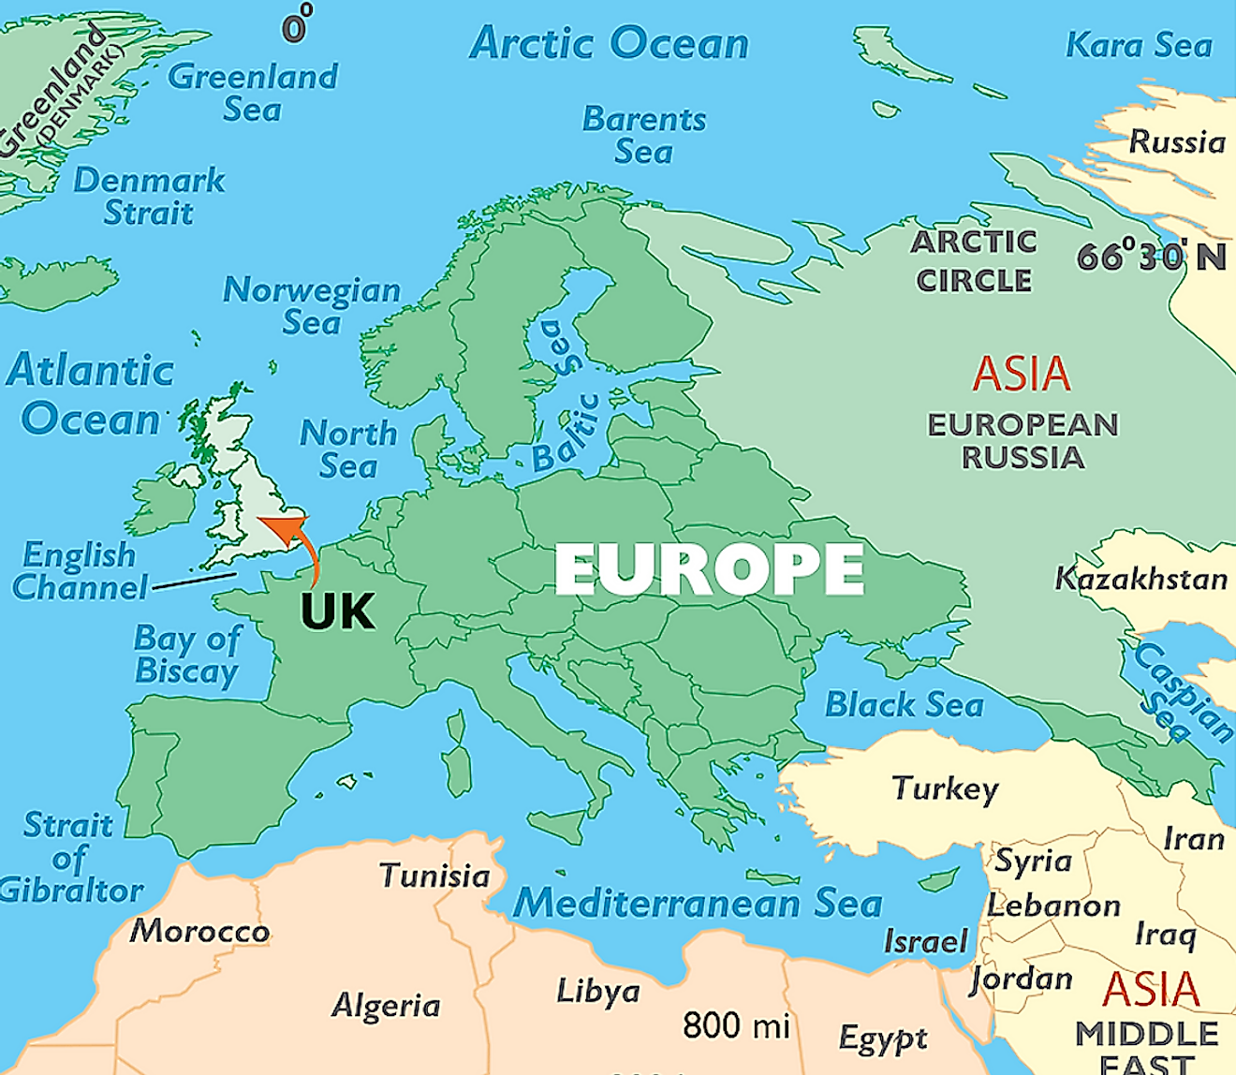
The Question of the United Kingdom

Slide 15
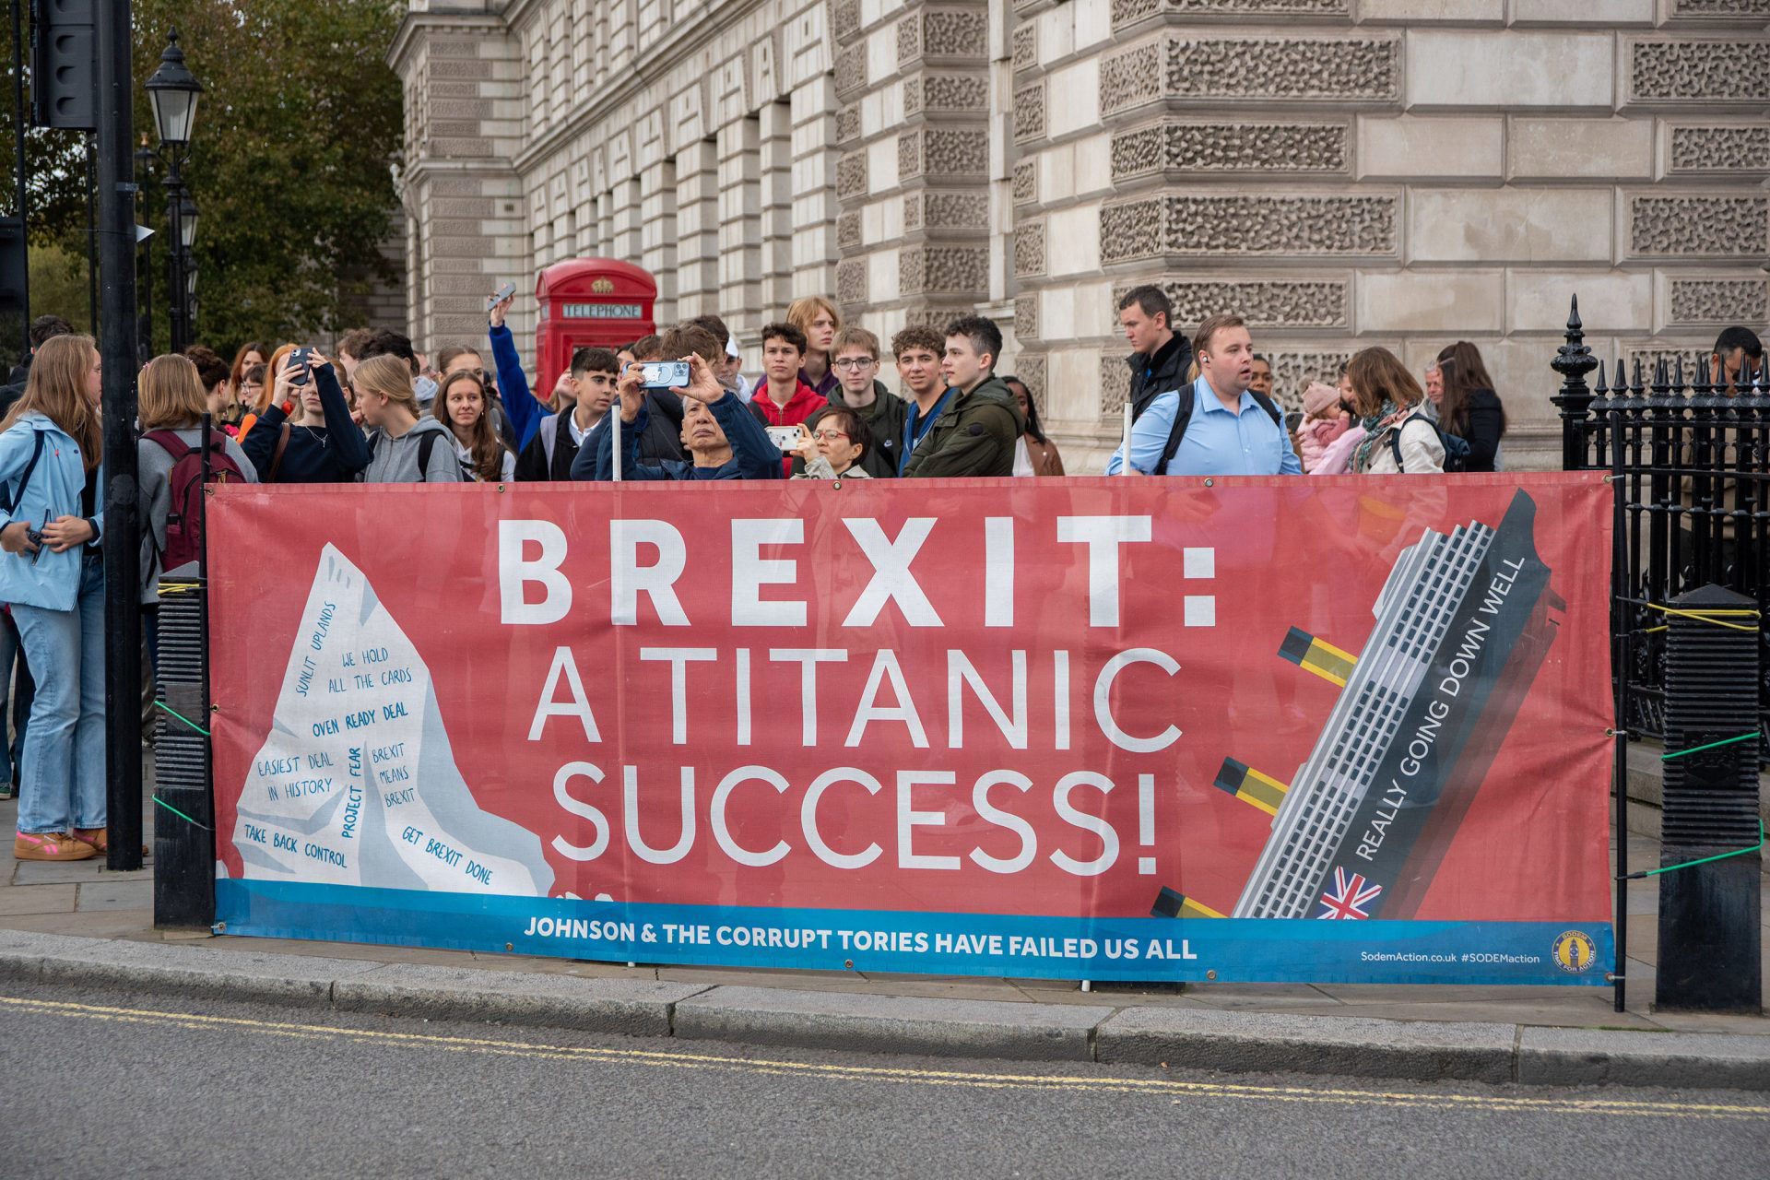
The Question of the United Kingdom

Slide 16
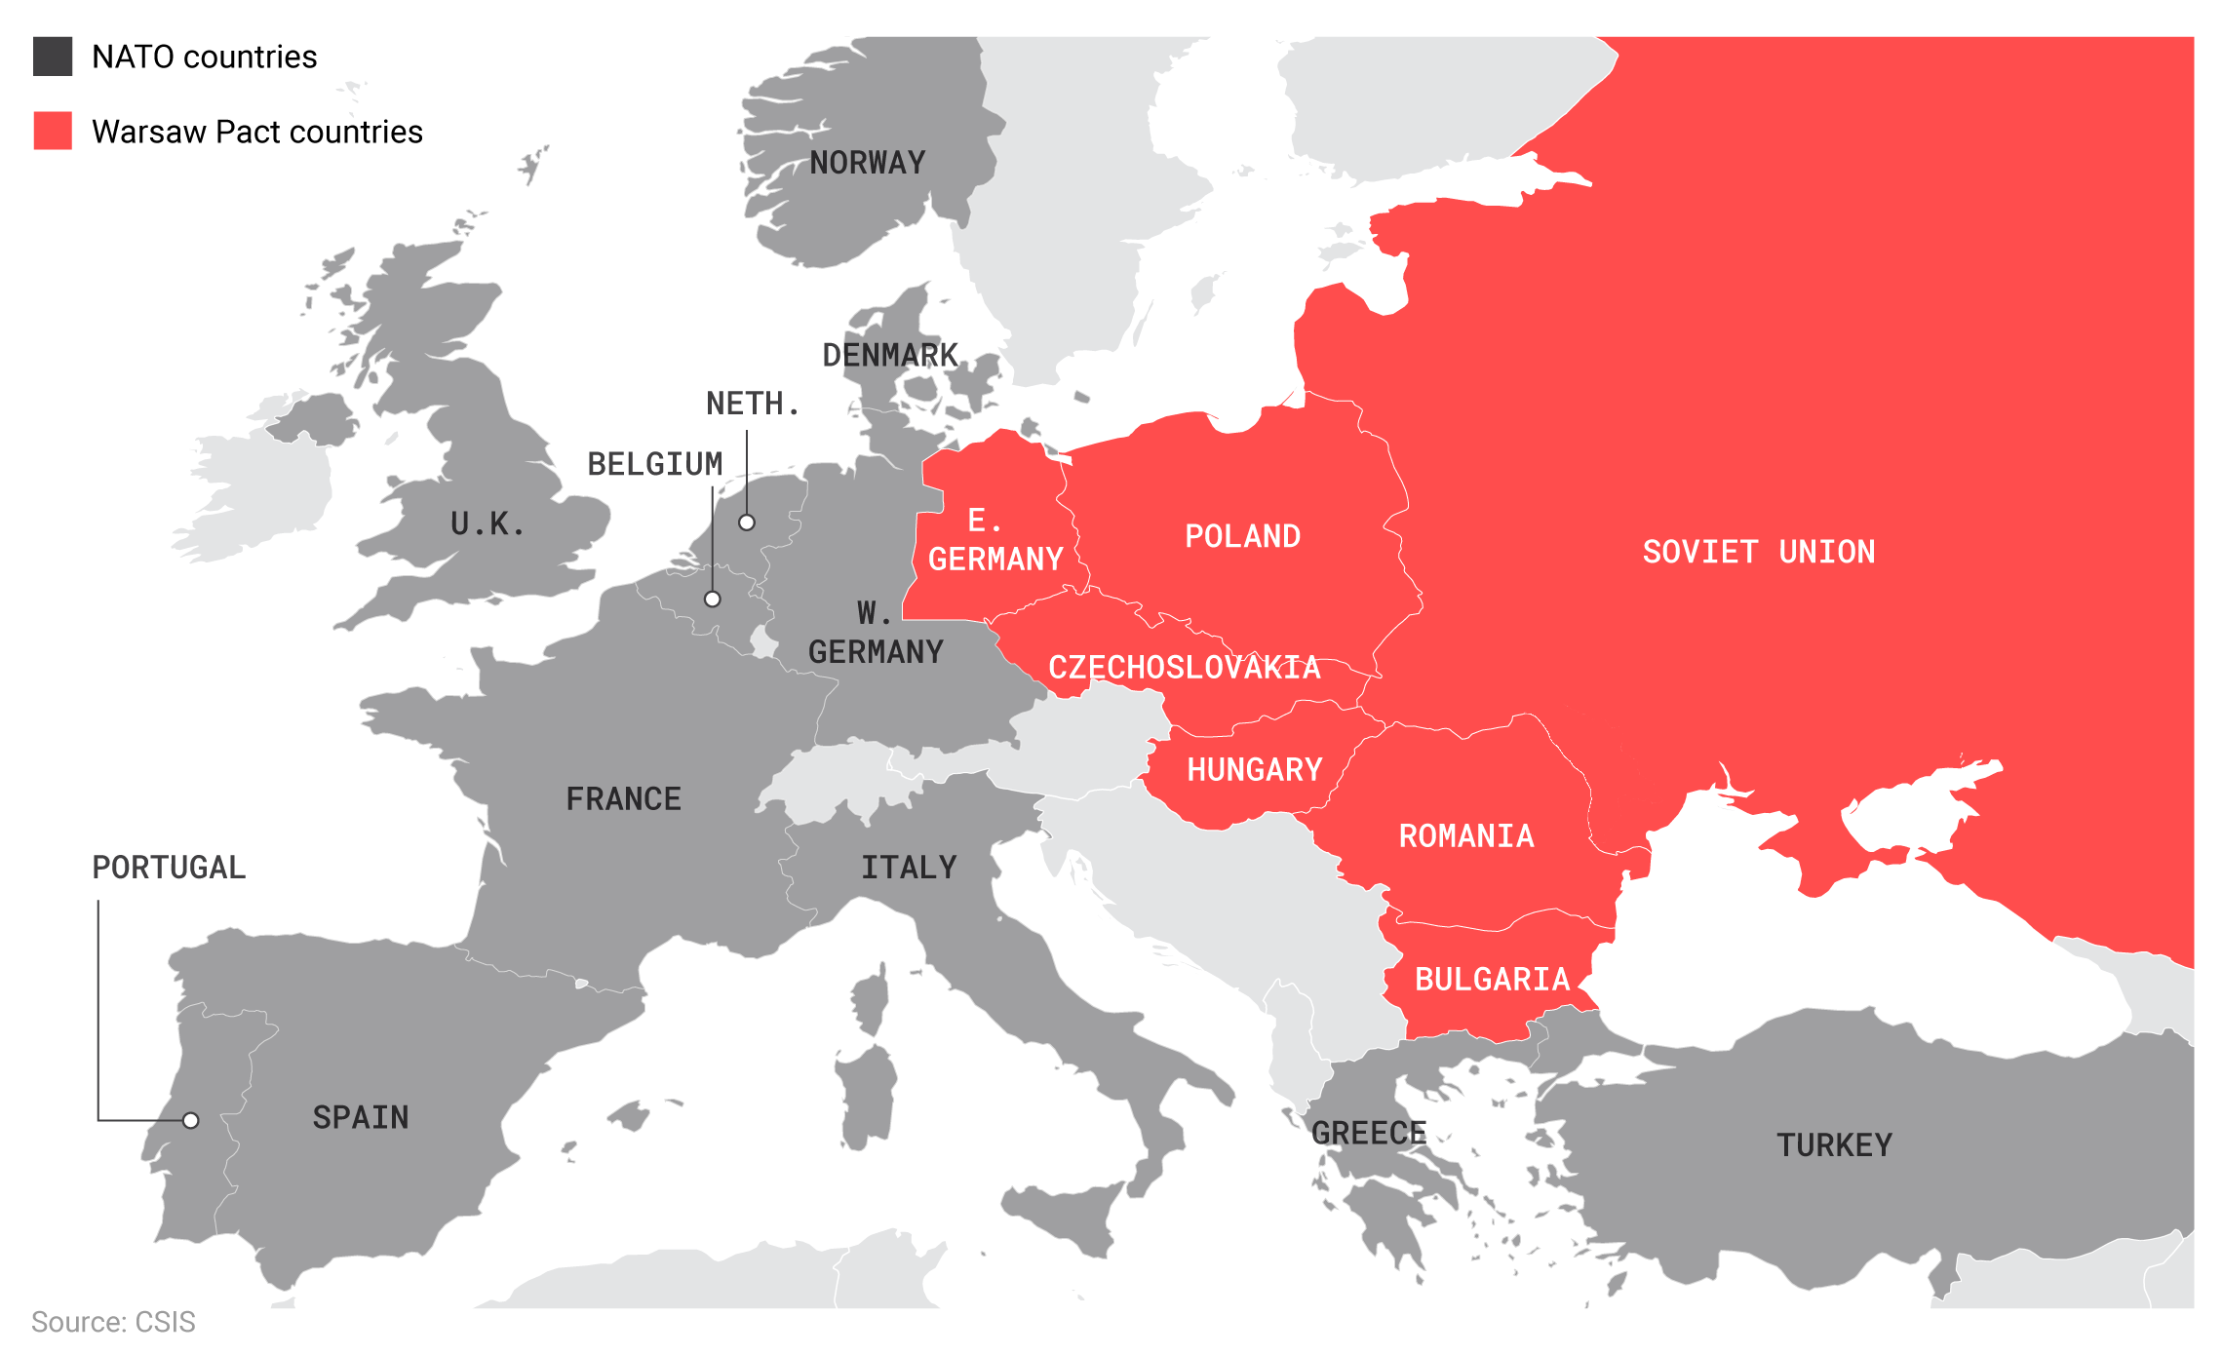
Cultural Sub-Divisions
NATO Countries
Warsaw Pact Countries

Slide 17
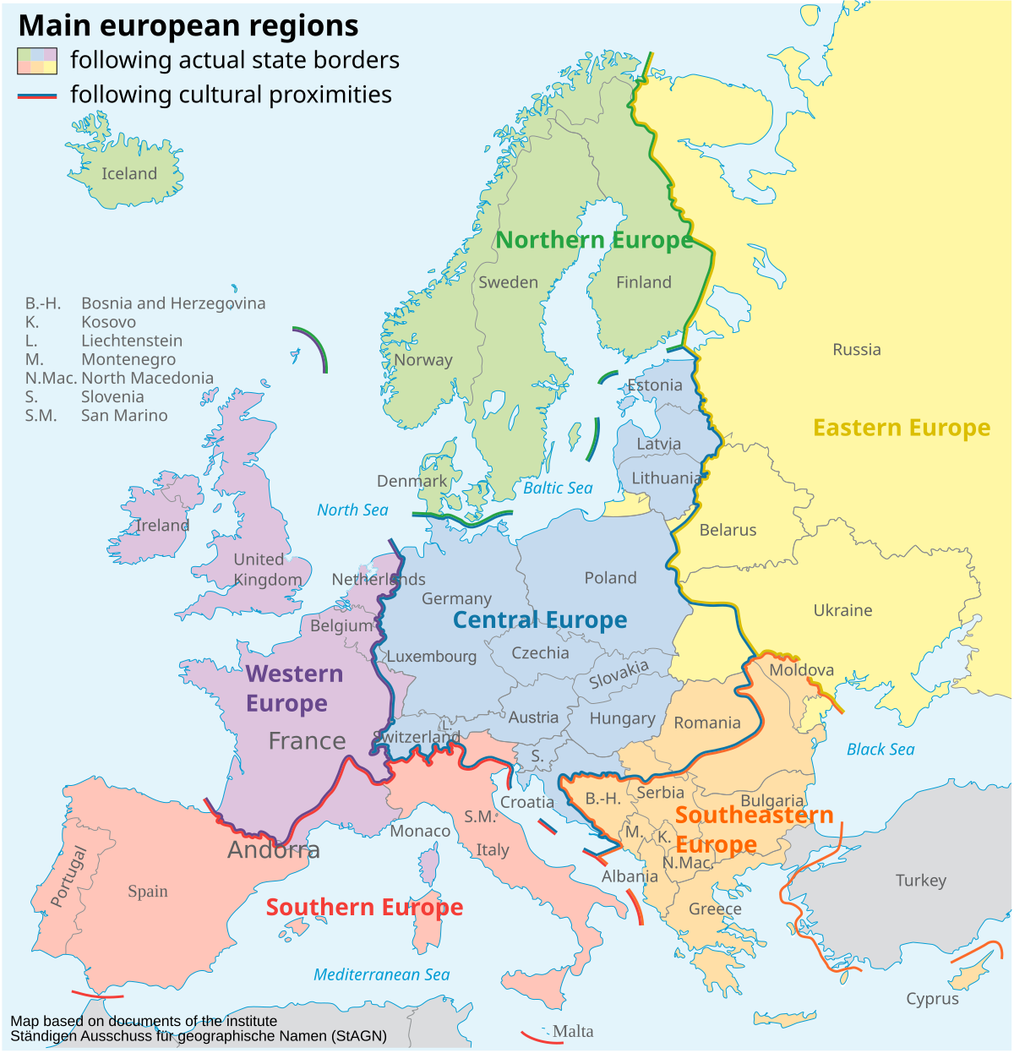
Cultural Sub-Divisions

Slide 18
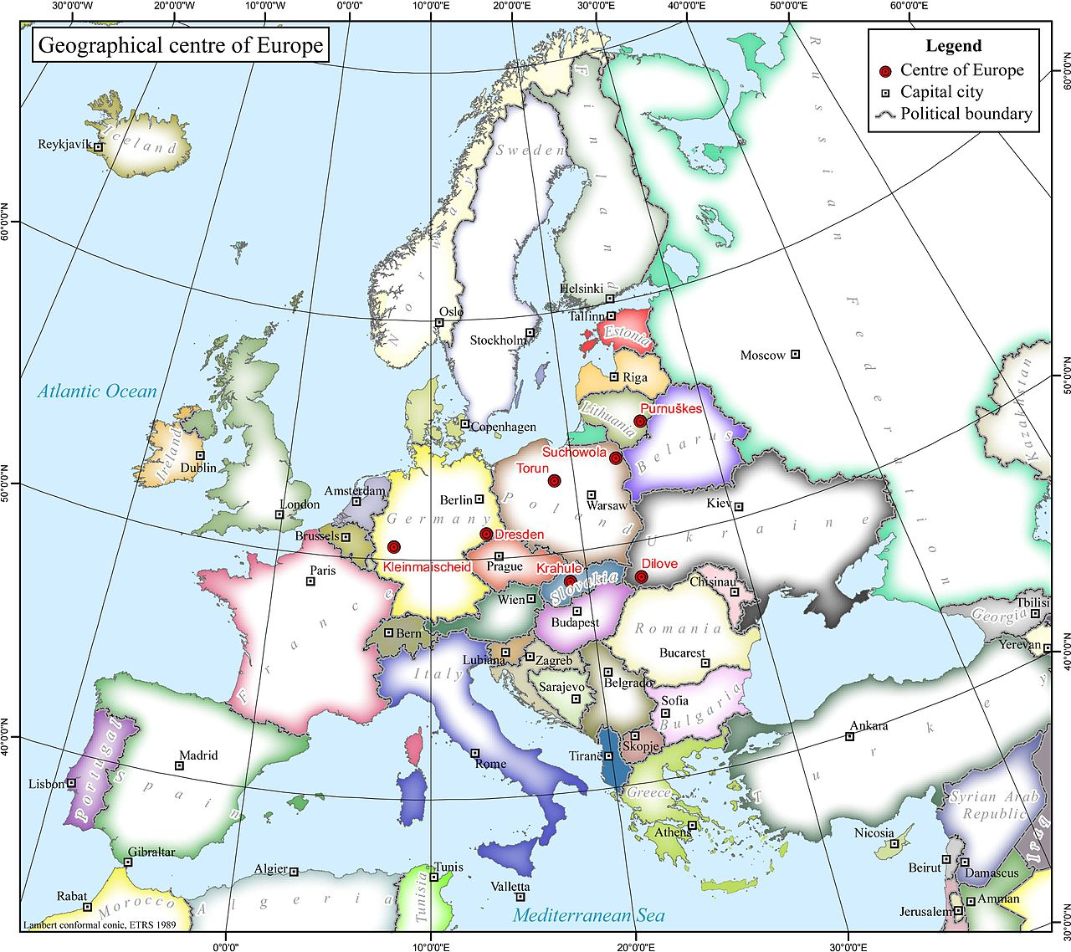
The Heart of Europe?

Slide 19
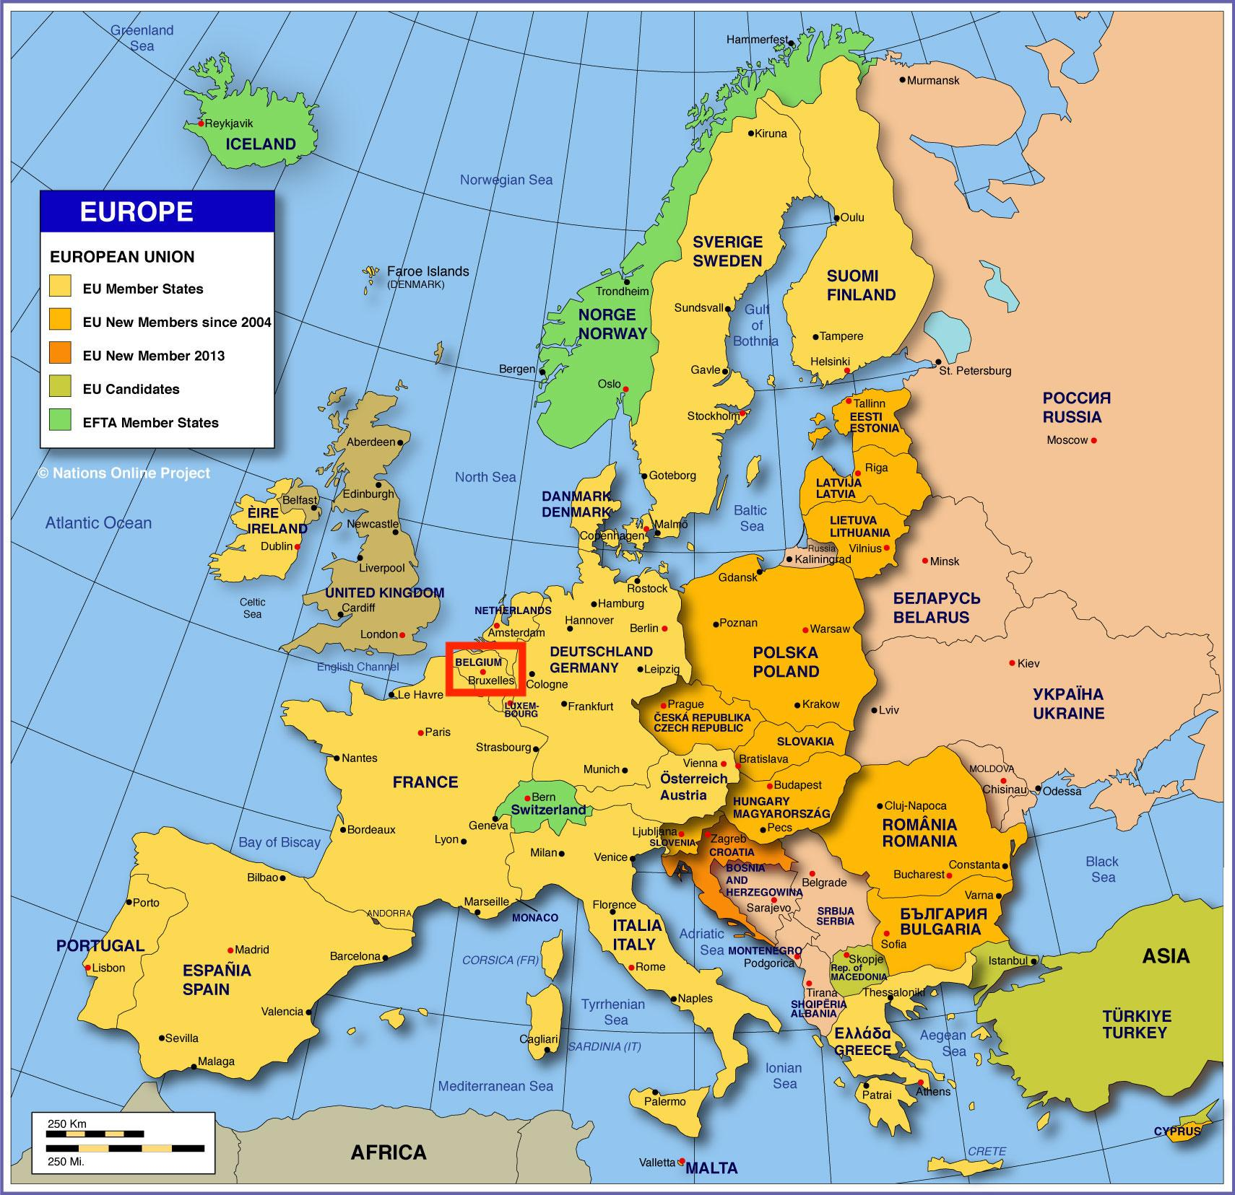
The Heart of Europe?

Slide 20
Europe today: Ideas and Institutions
Utopia of unity and harmony
Aspired by the European Union
Political Democracy
Free markets
Legal framework for international relations and integration
Wide variation in workings and prospects of political democracy!

Slide 21
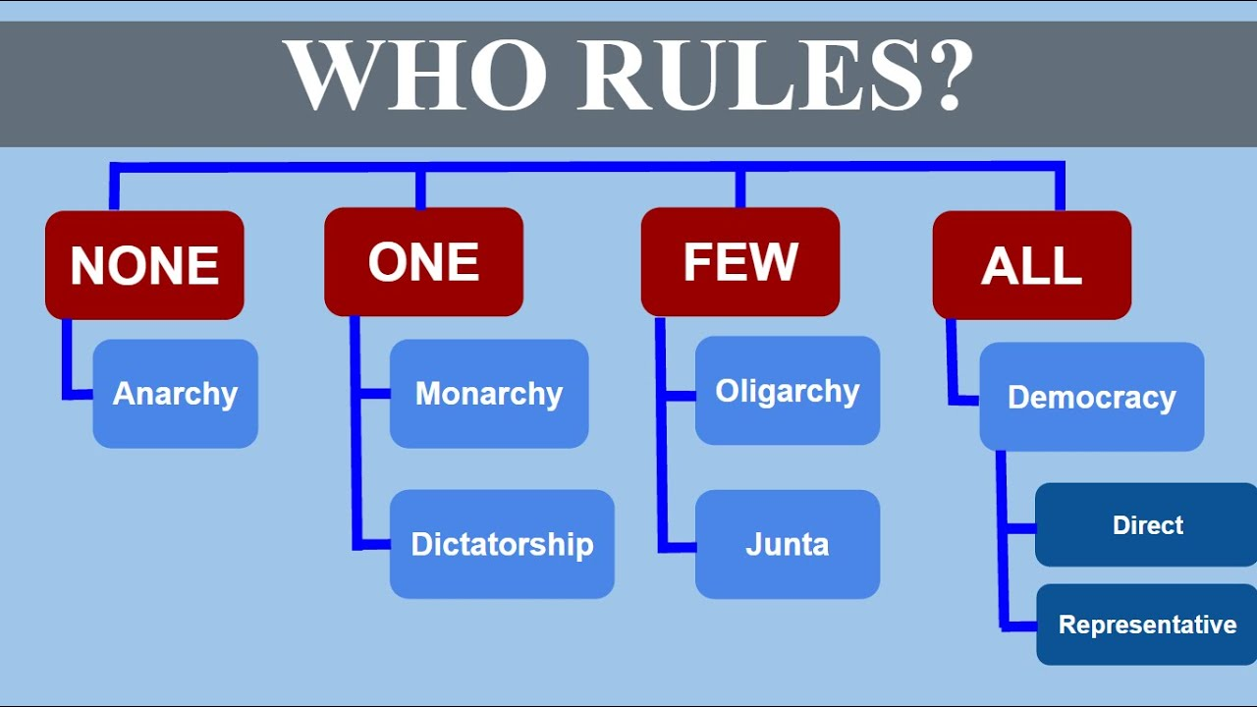

Slide 22
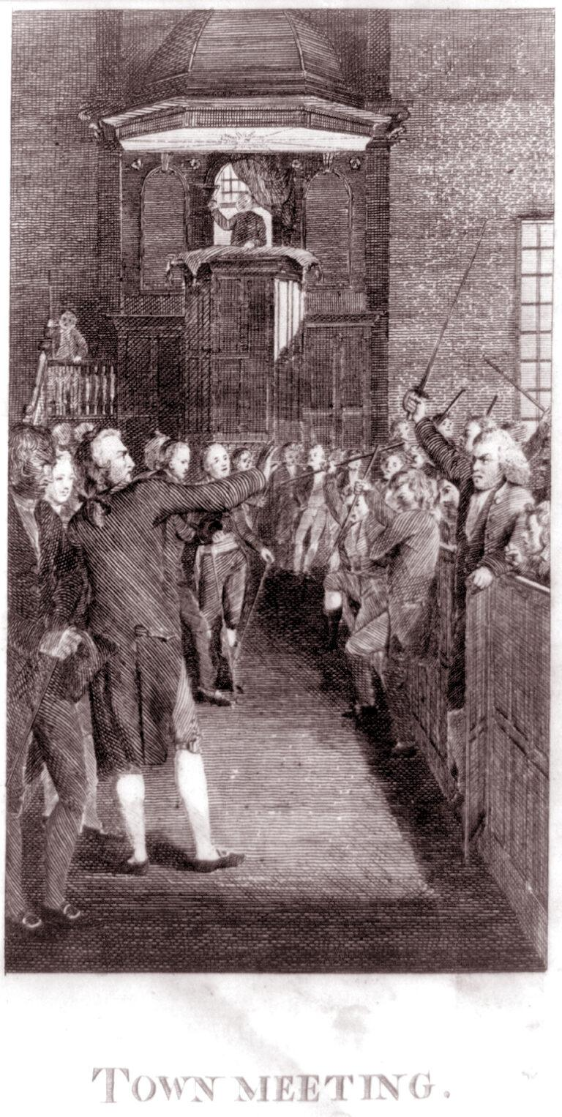
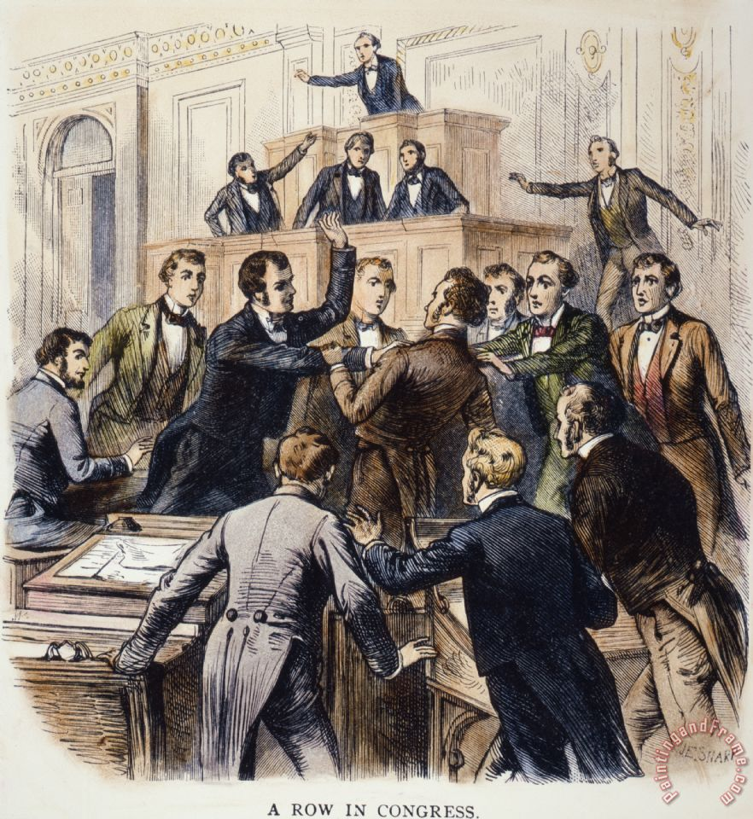
From town halls to representation

Slide 23
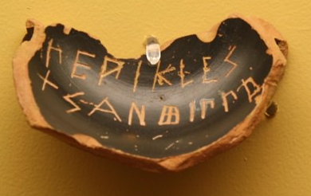
Dates back to Athenian Democracy
Assembly (all male citizens)
Finances, military, signing treaties, …
Ostracism
Council (500 elected citizens)
Agenda-setting for assembly
Acted by itself in crisis/war
Executive committee (1 of 10 tribes)
Law courts with randomly elected magistrates

Slide 24
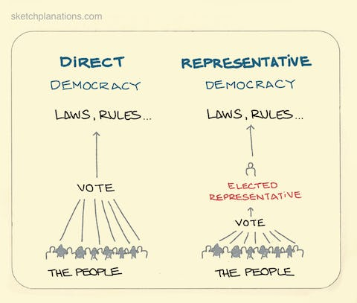
Direct vs Representative Democracy

Slide 25
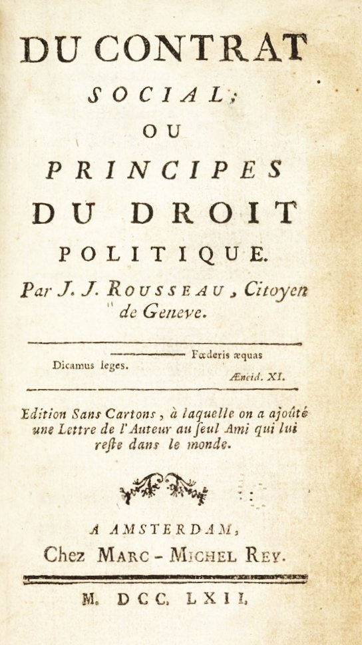
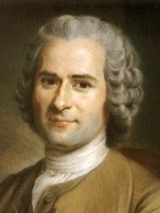
Purpose: Common Good & General Will
Against Plato's idea of the guardian
Good citizens are able to exert their will...
...and might have differing ideas about the common good
Homeless?
Women?
Minorities?

Slide 26
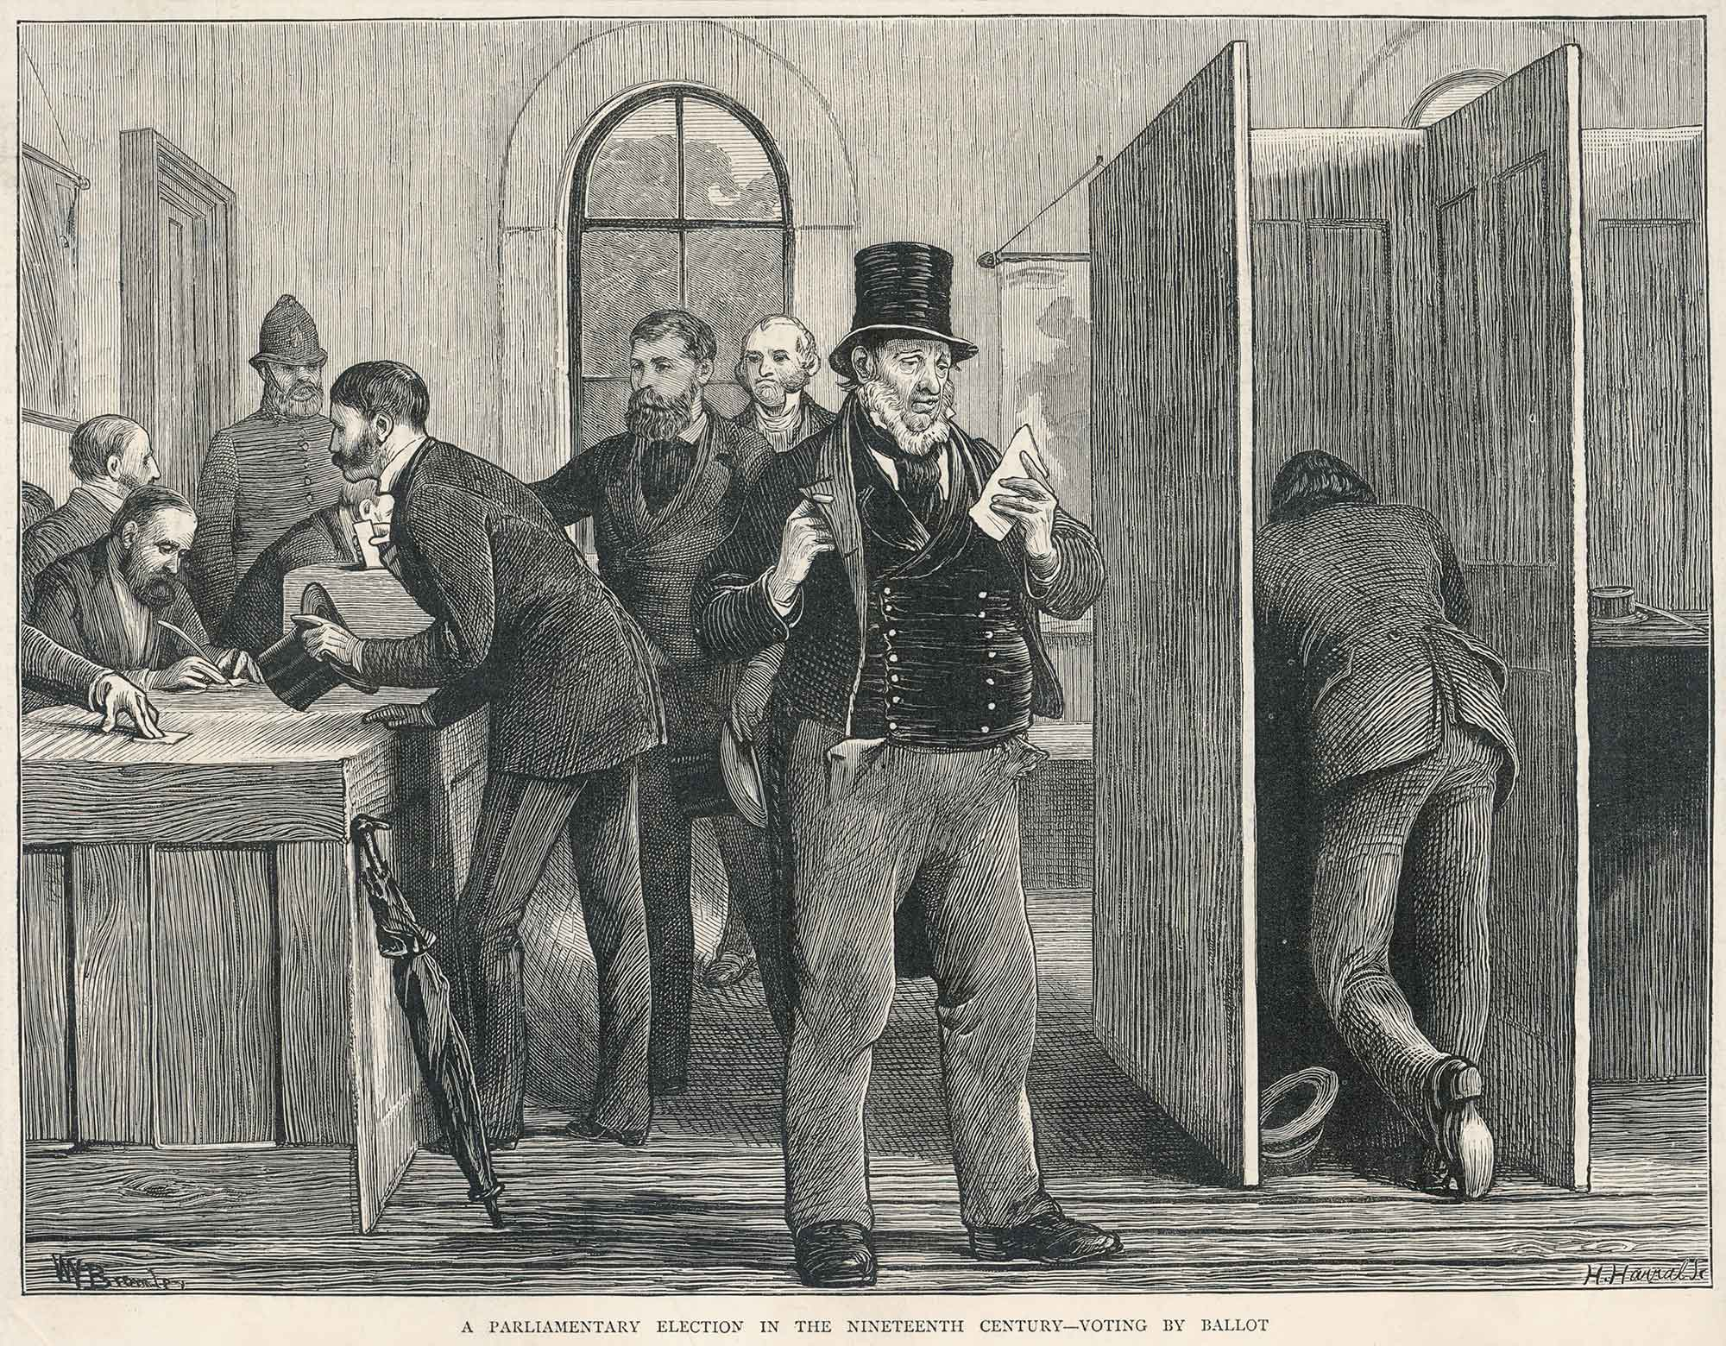
Free, Fair & Frequent Elections

Slide 27
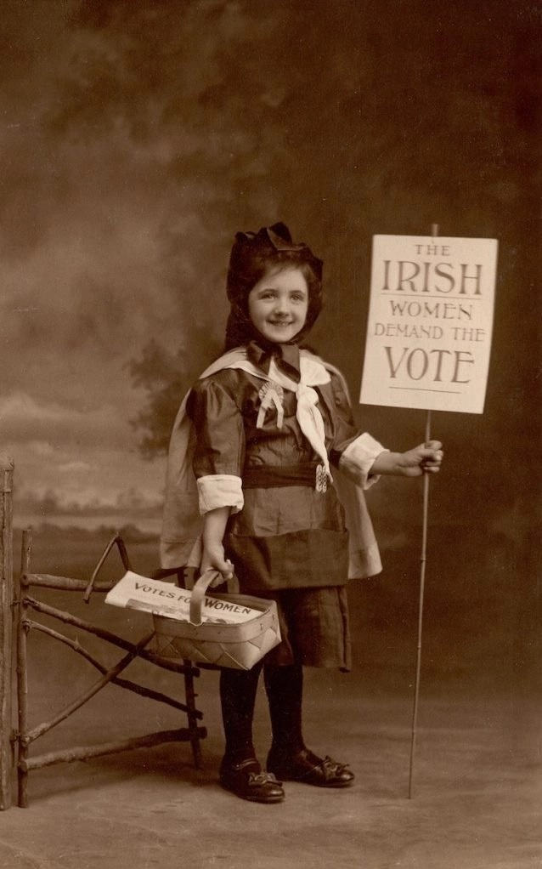
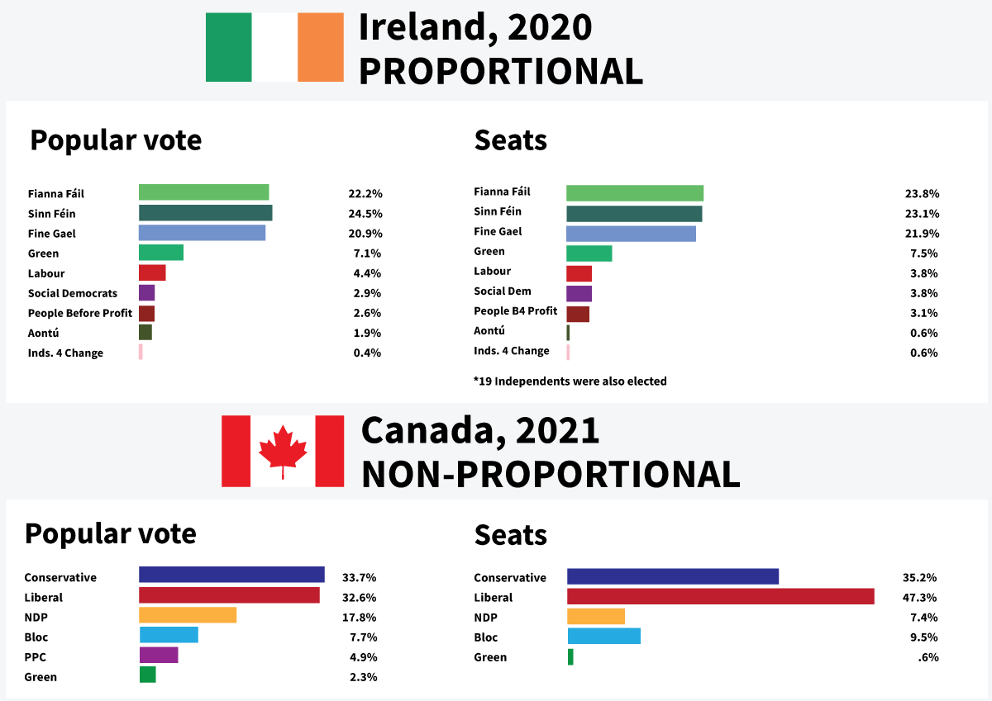
Free, Fair & Frequent Elections

Slide 28
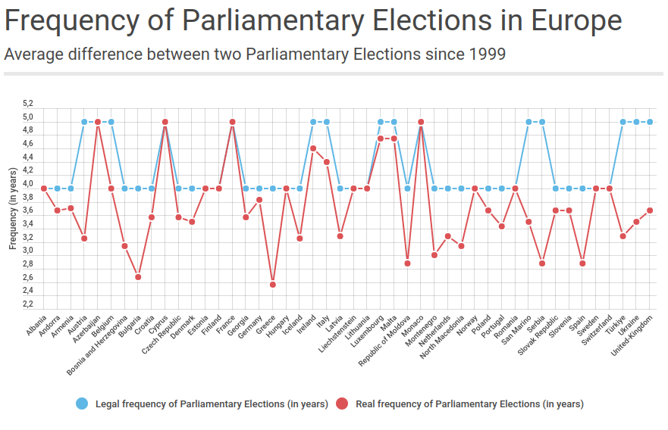
Free, Fair & Frequent Elections
https://www.coe.int/en/web/electoral-assistance/frequency-of-parliamentary-elections

Slide 29
Necessary Institutions for Democracy (Dahl, 1998)
Elected Officials
Free, Fair and Frequent Elections
Freedom of Expression
Alternative Sources of Information
Associational Autonomy
Inclusive Citizenship
Criteria to decide if states = democracies!

